Slide 1
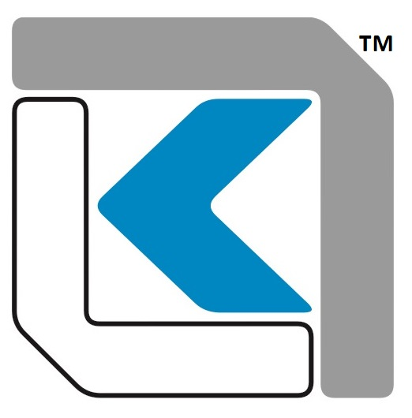
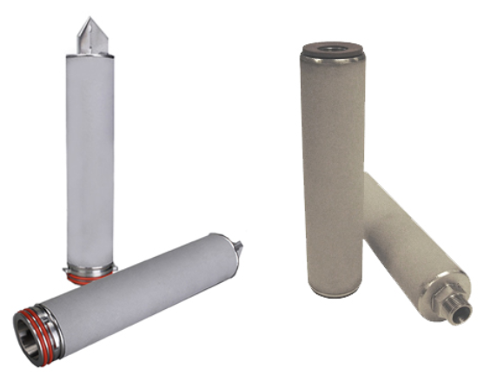
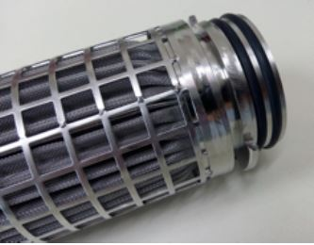
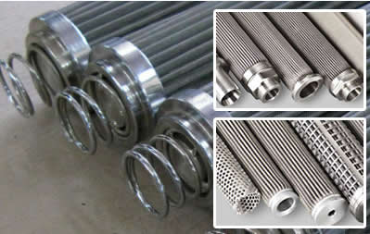
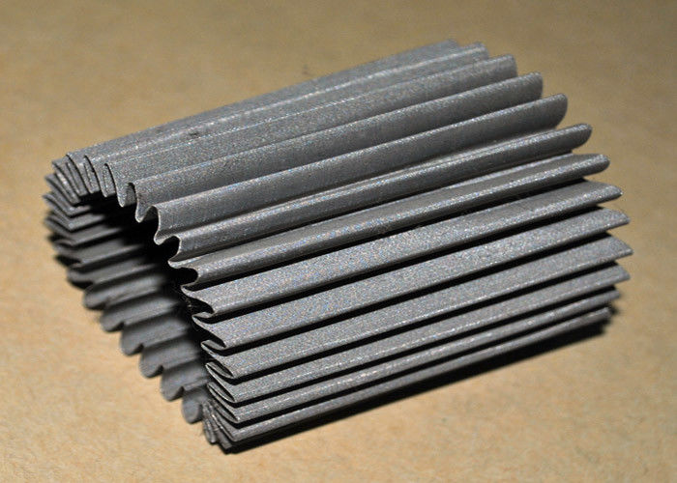
KGT METAL MESH FILTER
ABOUT
The KGT Wire Mesh Metal Filter cartridge has a rigid pore structure enabling removal of particles at higher differential pressures with consistent efficiency.
Apart from the wide chemical compatibility, the filters are suitable for either gas or liquid having a high dirt holding capacity.
The KGT Wire Mesh Metal Filter cartridge is available in SS304/SS316 and SS316L.
ADVANTAGES
Due to wide range to media selection, a variety of liquids from acids to alkalis; from seawater to process water; and in gases from air to fuel gas to hot exhaust gases.
Standard dimensions of 2.5” outer diameter and 1” internal diameter ensures fitment in most standard housings with varied length availability. (other dimensions are available on request)
Available in 10 / 20 / 30 / 40 / 60 inches length. (Other lengths available on request.)
Solid internal core ensures optimal strength and withstanding of differential pressure.
DIFFERENCIAL PRESSURE DATA
For Normal Flow from Outside to Inside for liquids compatible with the filter media, the maximum differential pressure is 1.5 bard (22 psid) @ 75⁰C.
APPLICATIONS
Corrosive Fluids Steam
Amine, Glycol Thermic Fluids
High Temperature applications in liquids and gases

Slide 2
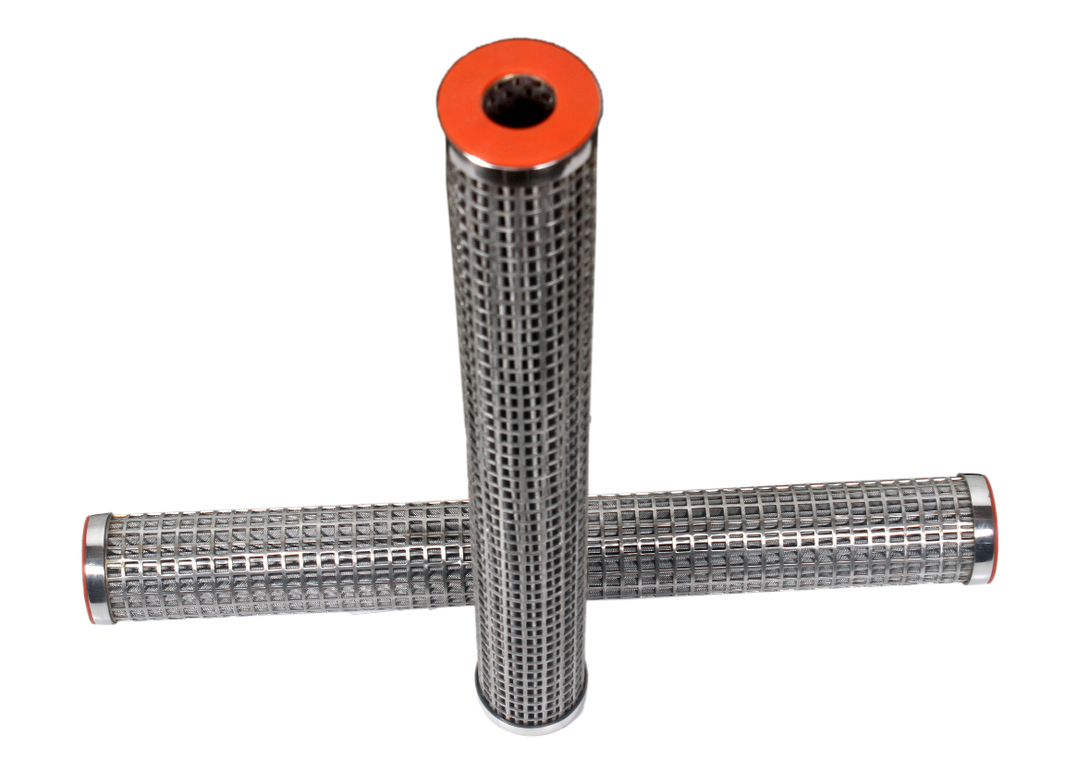
KGT METAL MESH FILTER
PART NUMBERING GUIDE
Filter Element Part Number : KGT - - - M - -
Short Code Description Short Code Description
010 1 μm 020 2 μm
030 3 μm 050 5 μm
100 10 μm 200 20 μm
300 30 μm 400 40 μm
500 50 μm 700 70 μm
1000 100 μm 2000 200 μm
(Other Removal Ratings are available as per requirements)
Short Code Description
Length (inches)
10 10
20 20
30 30
40 40
60 60
Filter Media
Short Code Material Of Construction
SS SS304
SST SS316
Filter
Short Code Fitment Style
7 Size 226 double O-rings, flat top
0 Double Open end with Gaskets
3 SOE with NPT Threads
 6, Anurag, Rajaji Path, Ramnagar, Dombivli, Mumbai, 421201, Maharashtra, India
 +91 251 2420878  +91 9166 593 315  solutions@klengas.com

